Slide 1


Data Mining to Improve
Student Outcomes
Team Six:
Nish Garg
Christopher Lucas
Aditi Sharma
Nelson Wang
Bill Wilson
Data Analysis and Visualization

Slide 2
Data Source
Texas Education Agency
Texas Academic Performance Report
Snapshot: School District Profiles
Download of .dat files and imported as .csv files
School years
2012–2013
2013–2014
2014–2015
2015–2016
Data Analysis and Visualization

Slide 3
Four Questions
What is the relationship between average teacher salary and student achievement?
What is the relationship between community type and student achievement?
What is the relationship between poverty and student achievement?
What conclusions can we draw from these relationships to improve student outcomes?
Data Analysis and Visualization

Slide 4
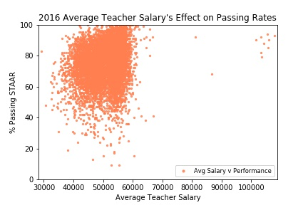
Relationship between teachers’ salaries and students’ performance
Student performance is not dependent on average teacher’s salary.
Further analysis can be done on the outliers.
Data Analysis and Visualization

Slide 5
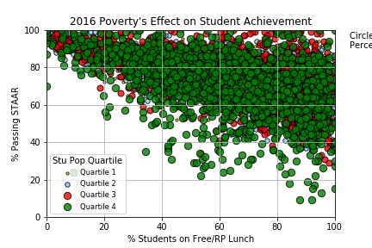
Relationship between poverty and student outcomes
Student population by quartile
Negative relationship
Varied dispersion by campus size
Data Analysis and Visualization

Slide 6
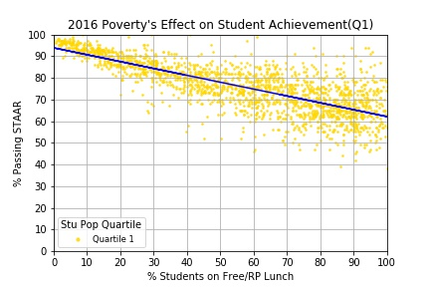
Relationship between poverty and student outcomes
First quartile of student population
Least variance
Data Analysis and Visualization

Slide 7
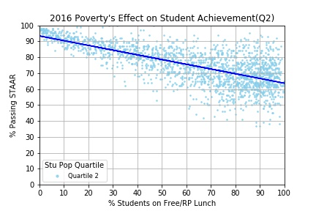
Relationship between poverty and student outcomes
Second quartile of student population
Increased Variance
Data Analysis and Visualization

Slide 8
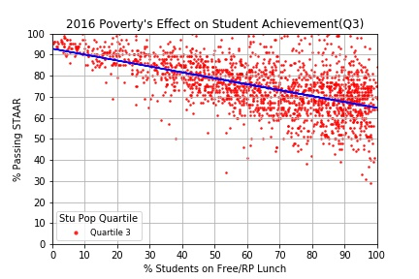
Relationship between poverty and student outcomes
Third quartile of student population
Greater variance
Data Analysis and Visualization

Slide 9
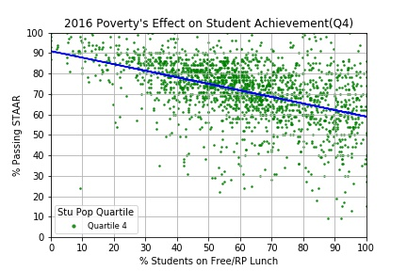
Relationship between poverty and student outcomes
Fourth quartile of student population
Greatest variance
Data Analysis and Visualization

Slide 10
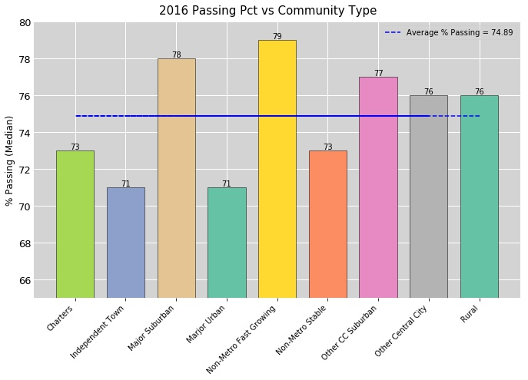
Relationship between community type and student outcomes
Highest passing rate- 78%.
Lowest passing rate – 71%
Average % Passing – 74.89%
Data Analysis and Visualization

Slide 11
Top schools
Campus ID | Campus | % EcoDis | % Passing | Community Type | Average Salary
108904101 | AUSTIN EL | 94 | 98 | Other Central City | $ 55,486
240901008 | EARLY COLLEGE H S | 95 | 98 | Other CC Suburban | $ 56,644
226906002 | FAIRVIEW ACCELERATED | 100 | 100 | Other CC Suburban | $ 41,957
057835101 | GOLDEN RULE | 95 | 100 | Charters | $ 53,967
071902119 | HAWKINS EL | 97 | 91 | Marjor Urban | $ 51,545
108912008 | JIMMY CARTER ECHS | 98 | 94 | Other Central City | $ 52,982
108908004 | MISSION COLLEGIATE H S | 96 | 94 | Other CC Suburban | $ 53,923
101912308 | NORTH HOUSTON ECHS | 92 | 99 | Marjor Urban | $ 57,630
031901139 | ORTIZ EL | 97 | 92 | Other Central City | $ 50,088
108912010 | THELMA ROSA SALINAS ECHS | 98 | 93 | Other Central City | $ 51,753
Data Analysis and Visualization

Slide 12
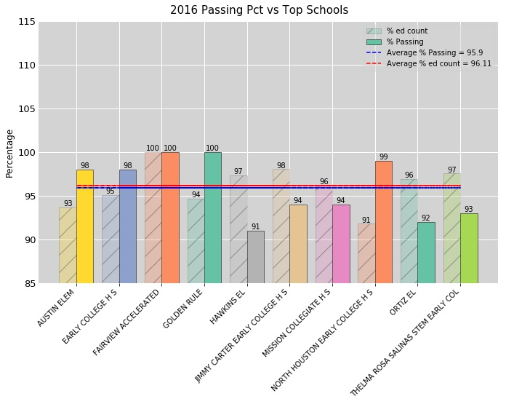
Relationship between top schools and student outcomes
Highest passing rate and count of schools
Lowest passing rate and count of schools
Average % Passing
Data Analysis and Visualization

Slide 13

Questions
?
Data Analysis and Visualization

